Slide 1

Instagram

Slide 2
NAME | NUID
Saaketh Chaganty | 002749652
Nikhil Kotha | 002651481
Vivek Reddy Alla | 002843447
Ansh Rathod | 002840576

Slide 3
Project Description:
An Instagram clone website aims to provide a social media platform that imitates Instagram's features and functionalities. With the ability to share photos and videos, follow other users, like and comment on posts, among others, Instagram has become a highly popular social media platform. An Instagram clone website would similarly offer these features and allow users to share their media, follow others, and engage with their community.
There are several reasons why one might choose to use an Instagram clone website, including the creation of a new social media platform that caters to a specific niche or community. Additionally, some users may be looking for alternatives to Instagram, either because they are dissatisfied with the platform or simply looking for something different.

Slide 4
Tech stack
FRONT END | BACK END
HTML/CSS | Node.js
React
JavaScript
Bootstrap

Slide 5
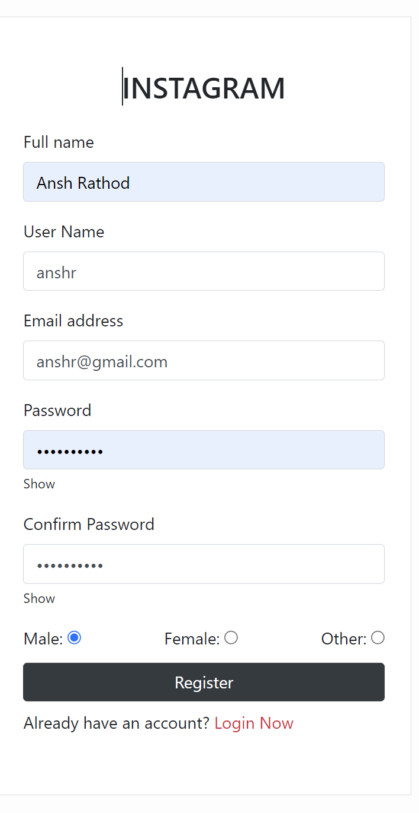
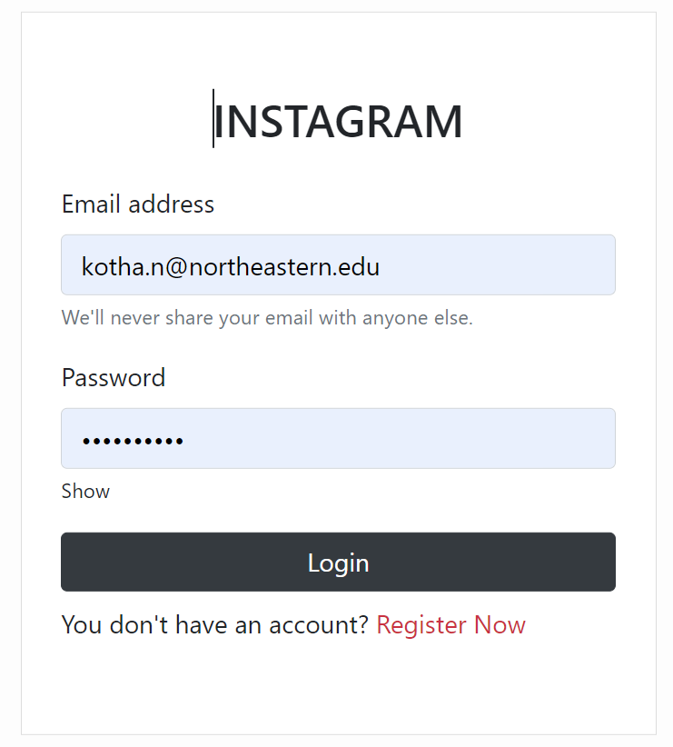
Screenshots of Instagram
User Login
Create new user

Slide 6
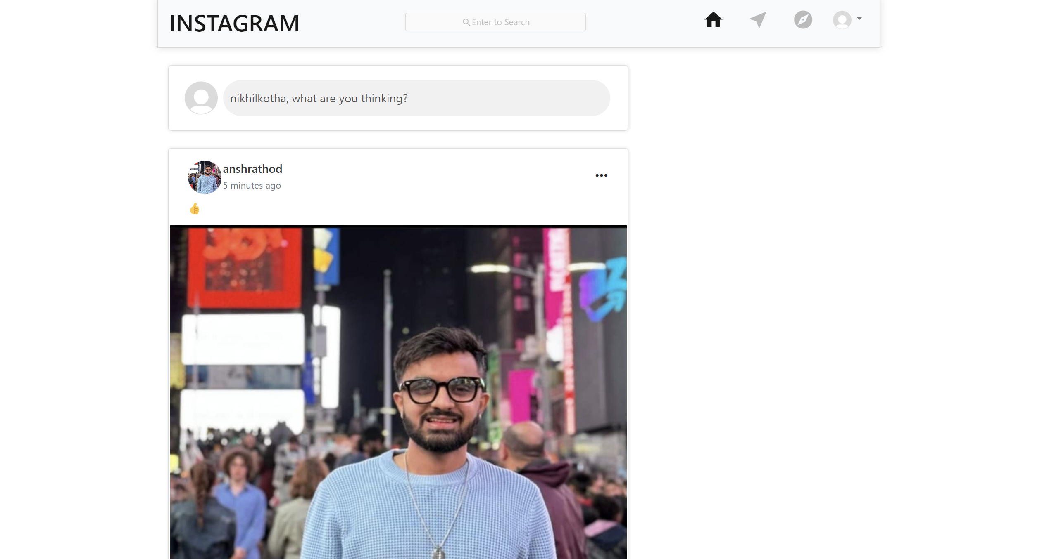
Home page

Slide 7
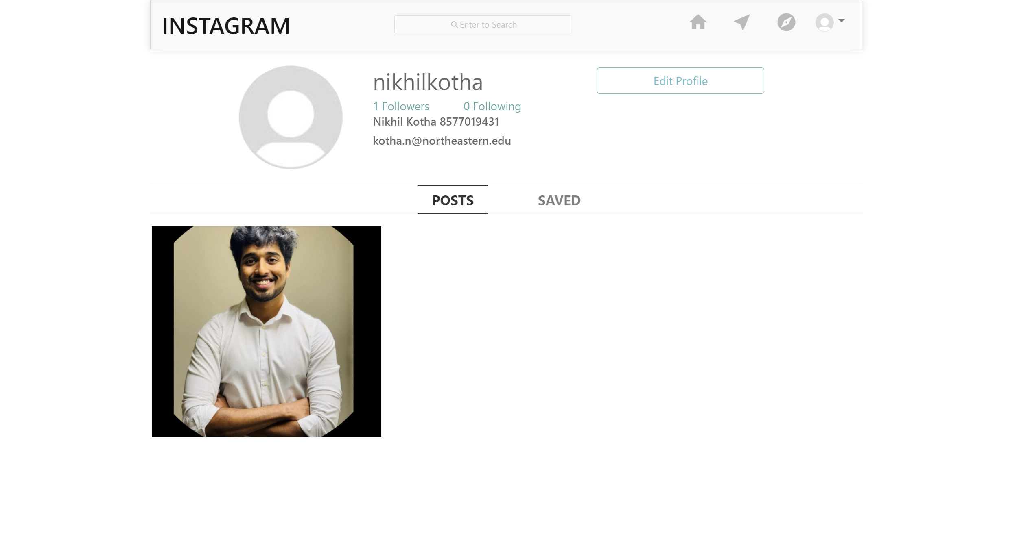
User Account

Slide 8
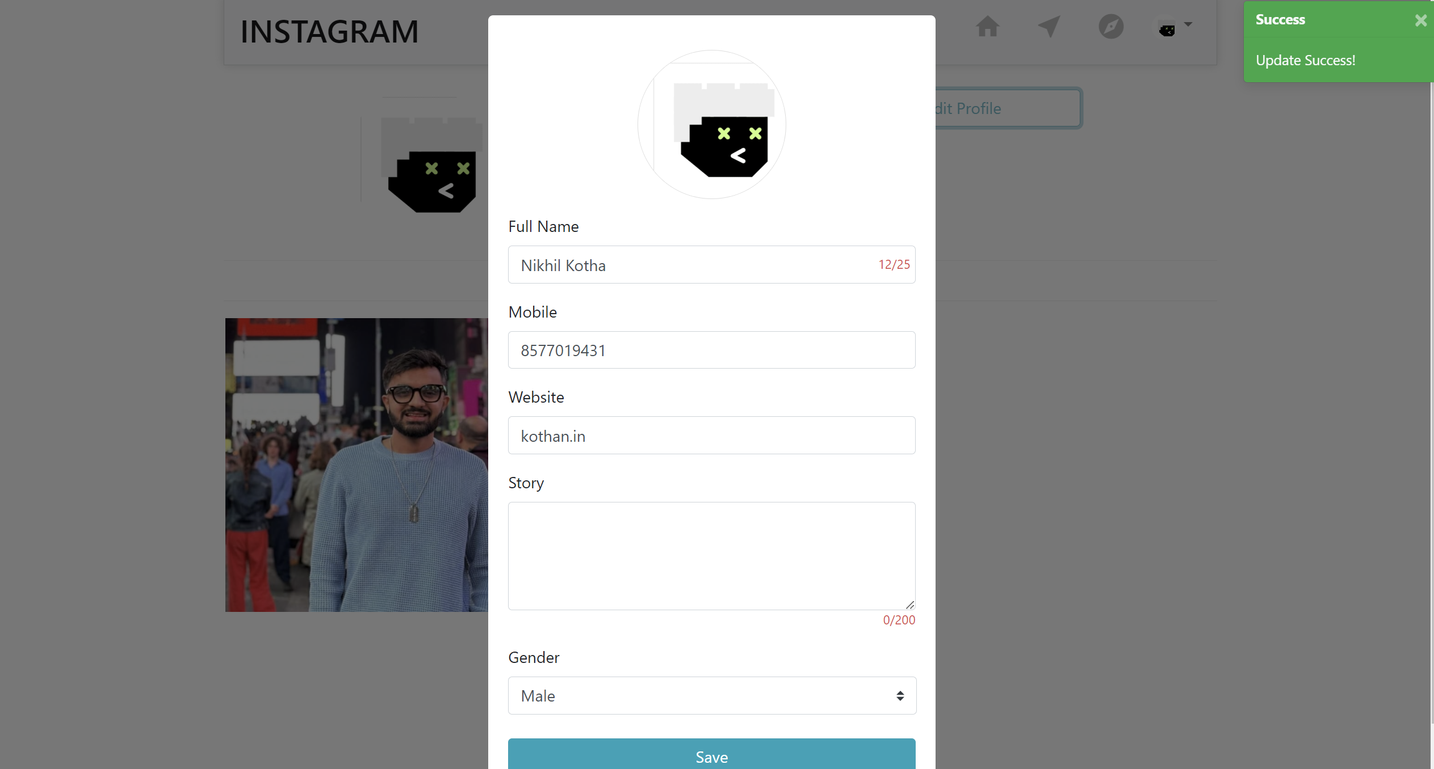
Edit information

Slide 9
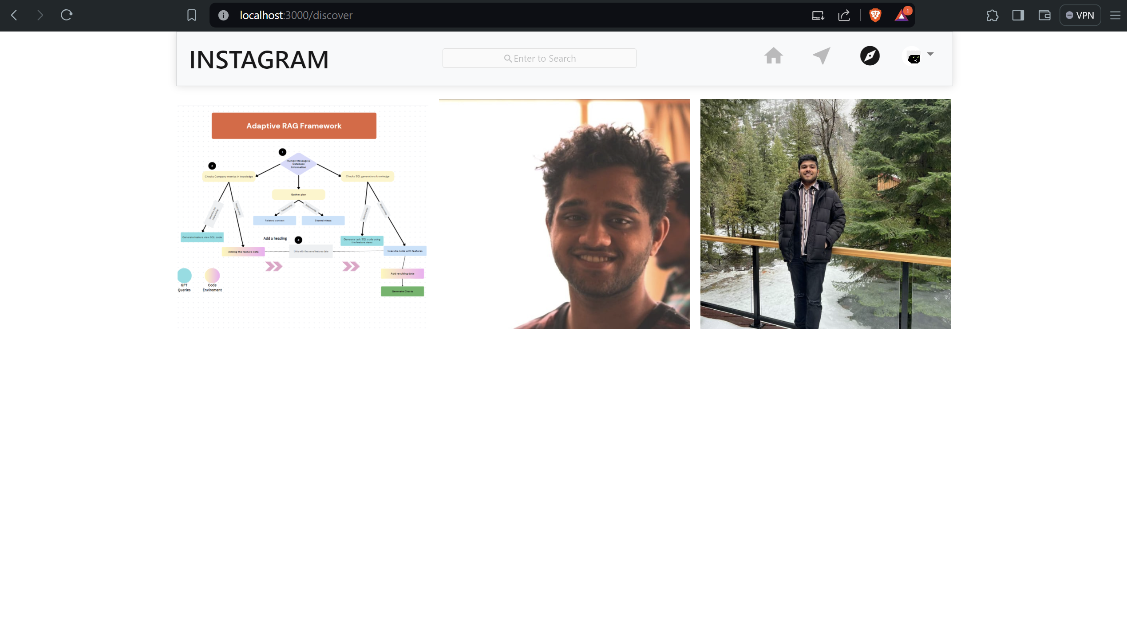
Discover page

Slide 10
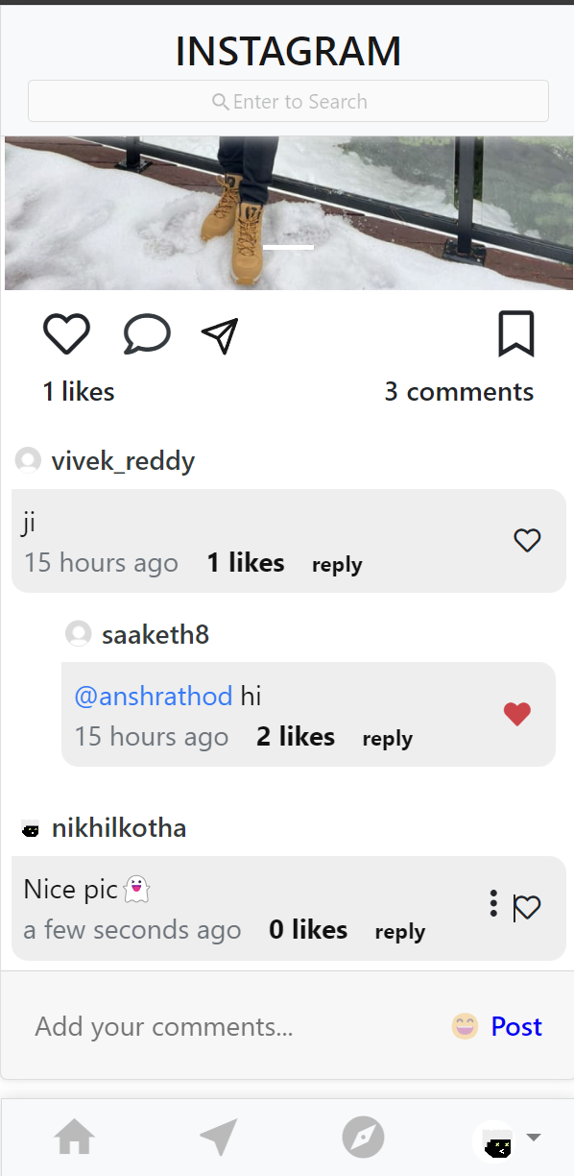
Instagram Feed
Each post has option to like, comment or share to an external source, replies to comments are also enabled

Slide 11
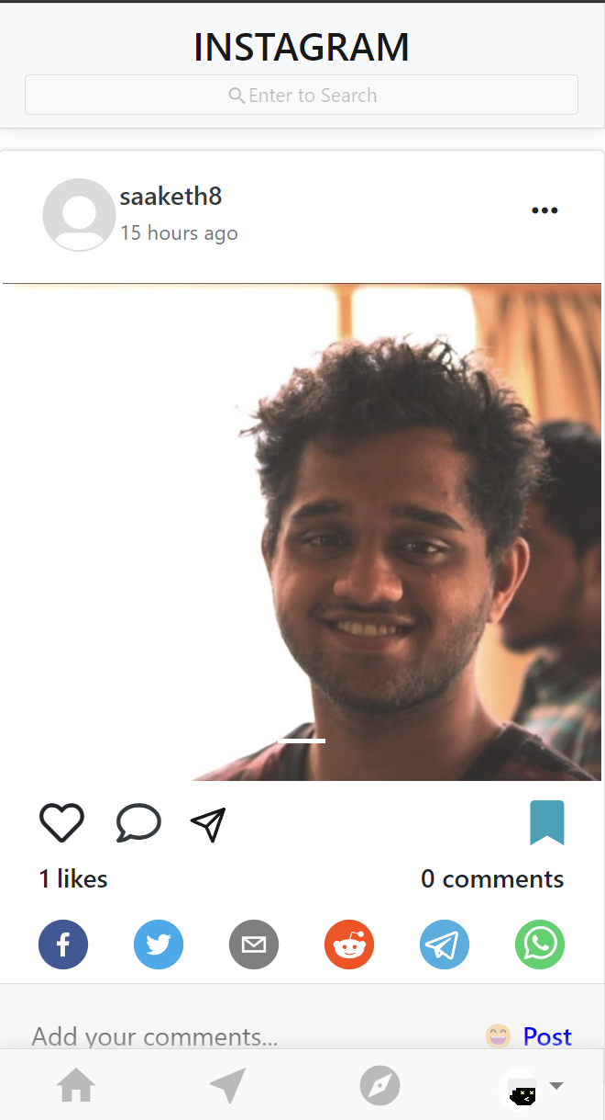
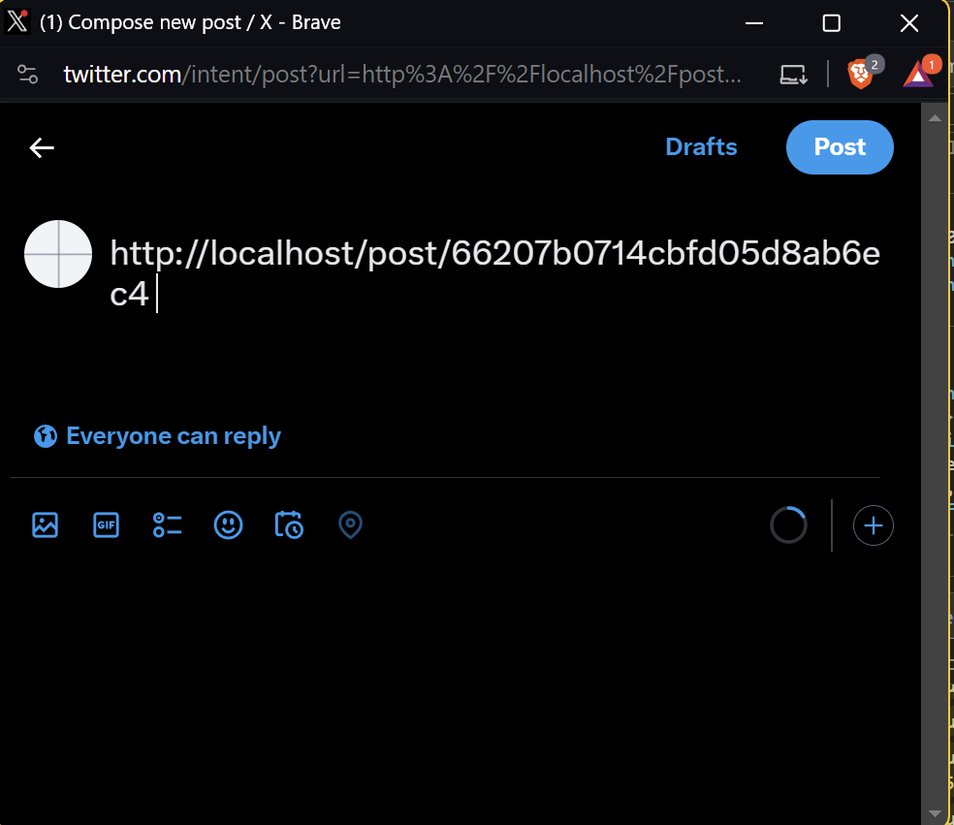
Share Posts

Slide 12
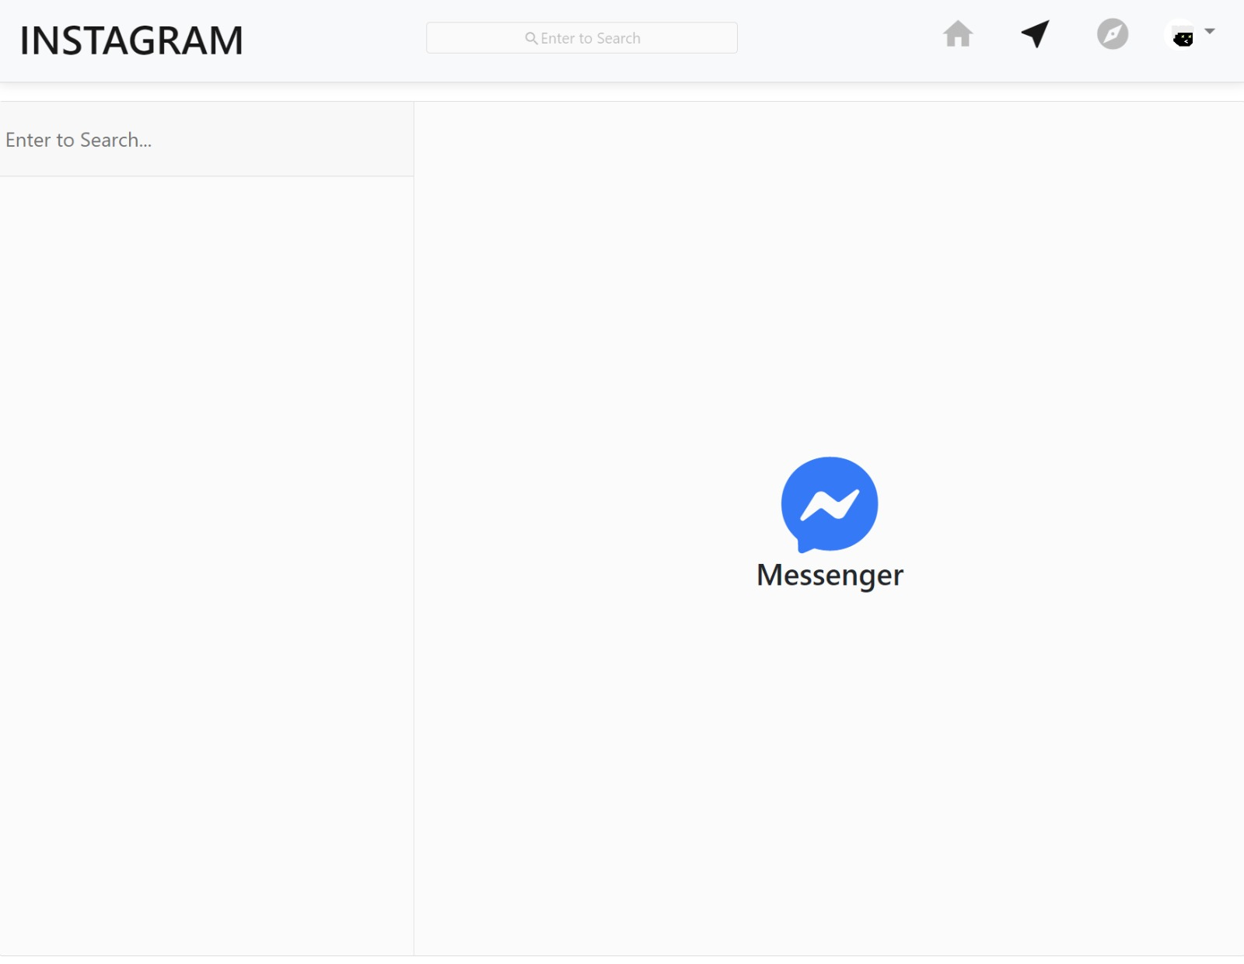
Messaging Page

Slide 13
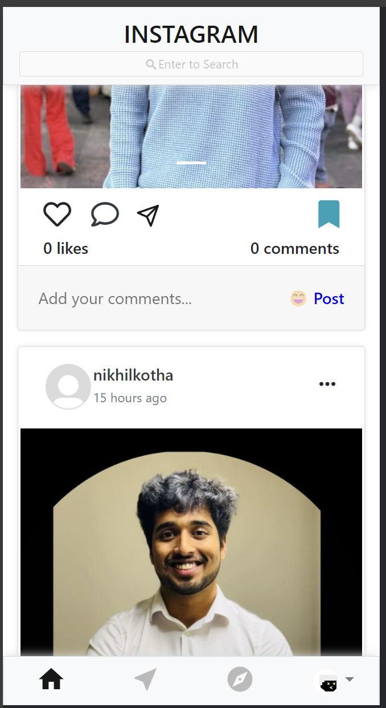
Mobile Responsive

Slide 14
Thank you

